Slide 1
Types of modelling tools
Many different ways of categorising modelling tools.
E.g.:
General and specific purposes;
Model structure: internal and external assumptions;
Analytical approach (top-down vs. bottom-up);
Mathematical approach;
Geographical coverage;
Sectoral coverage;
Time horizon (short, medium, and long term); and
Data requirements.

Slide 2
Types of modelling tools
Many different ways of categorising modelling tools.
E.g.:
General and specific purposes;
Model structure: internal and external assumptions;
Analytical approach (top-down vs. bottom-up);
Mathematical approach;
Geographical coverage;
Sectoral coverage;
Time horizon (short, medium, and long term); and
Data requirements.

Slide 3
Types of modelling tools
Draw on macroeconomic relationships and cross-sectoral dependencies.
MODELLING TOOLS
TOP-DOWN
ECONOMETRIC
INPUT/OUTPUT
CGE
BOTTOM-UP
ACCOUNTING
SIMULATION
OPTIMISATION
HYBRID MODELS
statistical analysis of historical time-series
interrelations between various sub-sectors of the economy
economy wide general equilibrium between sectoral demands and supplies
Projections based on socio-economic, technology and demographics
Accounting + rules (for dispatch, investments, …)
Calculate energy systems attributes driven by an objective function.
Provide a more detailed technological representation of the system.
Resource – to –use representation.
Mix of two or more of the above.
Notes:
Top-down models: draw on macroeconomic relationships to derive and inform insights. Can be used to assess the effects of cross-sectoral policies like carbón taxes or fuel subsidies. They lack technological detail.
Bottom-up models:
enable a more detailed technological representation within an energy system. They are useful when investigating issues such as the role of individual technologies or energy sector specific policies,such as technology emission targets.
They are characterised by their reliance on thermodynamic relations between production, conversión and use of energy carriers.
In general, they donnot take into considerantion cross-sectoral dependencies into account (we do in CLEWs).
Examples of Top-down:
Econometric: draw on statistical analysis of historical time-series as a basis for future projections. May base their projections on variables such as GDP, population, energy prices, etc.
I/O: consider the interrelations between various sub-sectors of the economy by capturing the monetary or Commodity flows between various sectors Can be seen as providign a static snapshotinterrelations are commonly represented in I/O tables listing the commodities consumed by a sector; or sectors consuming commodities. Commodity flows are frequenlty measured in monetary units. The level of detail is variable, and can be significant.
CGE (Computational General Equilibrium): are dynamic models that ensure that an economy wide general equilibrium between sectoral demands and supplies occurs. [General equilibrium: occurs when prices have adjusted so that demand equals supply of all commodities in the whole economy]. CGE models ensure that such an economy-wide equilibrium occurs. CGE models enable a more dynamic assessment of policy measures tan I/O models, due to their relieance in production functions (these are based in elasticities to specify the iutput as a function of its combination of inputs such as material, labour, capital and energy – for example).
Examples of Bottom-up:
Accounting frameworks: e.g. MAED, LEAP*; applied to assess differences between scenarios; all elements and interrelations are defined by the user; their are simpler which enables transparency of the assumptions;
Simulation models: e.g. energy systems models, production simulation models (and in these different methods: derating; probabilistic production cost simulation; Monte Carlo Simulation)
Energy systems simulation models (EnergyPLAN, WEM*): simulates the energy system and its operation (e.g. can include simple rules for dispatch or future investments). They may simulate consumer and producer behaviour in response to drivers such as income, energy security, public policies and endogenous energy prices. Allplayers may pursue and optimise their own goals indvidually. The outcome may then diverge from the optimum configuratio. Example: EnergyPLAN, World Energy Model – WEM (IEA,informs the WEO) – the latter is driven by econometrically dereived assumptions on sectoral energy demands, which in turn are based on macroeconomic estimations of economic growth (e.g. GDP), demographics, fossil fuel prices and technological development. WEM may be considered an hybrid model as i results on a combination of macroeconomic approaches and simulation of technology choices.
Optimisation models (OSeMOSYS, MARKAL, TIMES, MESSAGE, LEAP-OSeMOSYS – optimisation only for the electricity system):
Calculate endogenously energy systems atributes (demands, capacity additions, technologuy investments, and dispatch). They are driven by an objective function subject to various physical, technical, environmental, economic and policy constraints.

Slide 4
Top-down tools: Econometric
Econometric models typically look at relationships between trends and then use these for projections
Simple examples include the relationship between household income and energy use
Others might include relationships between economic growth patterns

Slide 5
Top-down tools: Input/Output (IO)
IO models show interdependencies between sectors of a national economy or regional economies
They account for monetary in- and out-flows of each sector
They are based on an IO matrix of the country, representing what flows from sectors in the rows to sectors in the columns
They compute the multiplying effects in the economy of the variation of the output of one sector
Notes:
- Reading the IO matrix:

Slide 6
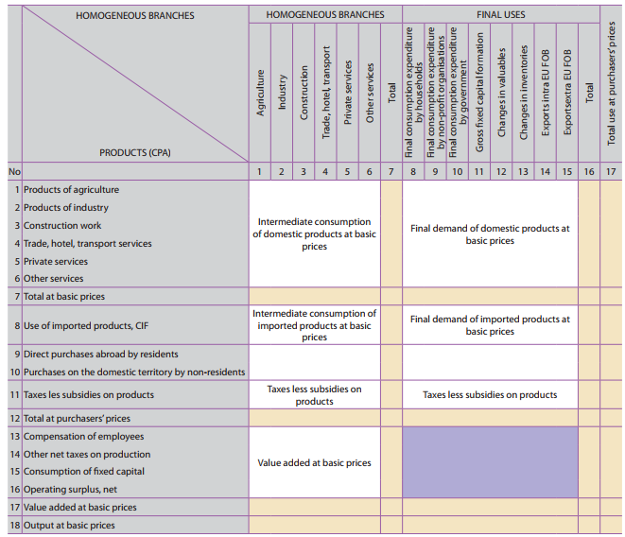
Example: IO table
INPUT
OUTPUT
EUROSTAT, 2008. Eurostat Manual of Supply, Use and Input-Output Tables.
Notes:
Input-Output Tables (IOTs) describe the sale and purchase relationships between producers and consumers within an economy. They can either show flows of final and intermediate goods and services defined according to industry outputs (industry × industry tables) or according to product outputs (product × product tables).

Slide 7
Top-down tools: CGE (Computable General Equilibrium)
Determine an equilibrium in the entire economy, and adjusts prices to get there
Outputs of the economy are produced as a function of various inputs
The inputs can be substituted for each other at various ‘elasticites’
Consider heating – one might substitute heaters for more insulation
Allows a wide and important range of policies to be assessed from energy technology to employment

Slide 8
Bottom-up tools: Accounting
Physical flows and energy balances
Examples include MAED and LEAP
Exogenously defined assumptions
Focus is on building scenarios
Have the strong advantage that they are simple and transparent
Other ‘bottom up’ models are based on these

Slide 9
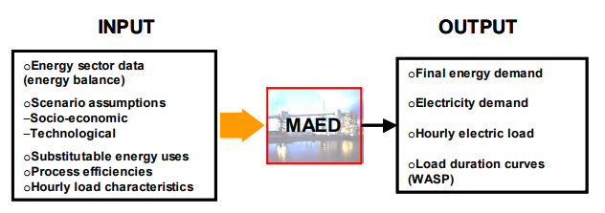
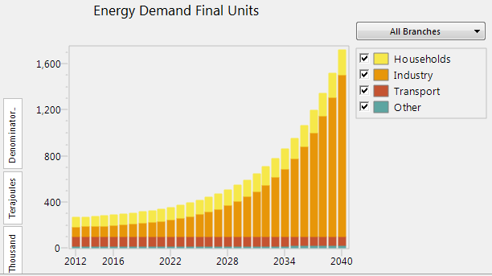

Example of bottom-up: accounting framework (MAED)
MAED
Model for Analysis of Energy Demand, IAEA
Notes:
MAED model evaluates future energy demand based on medium- to long-term scenarios of socio-economic, technological and demographic developments. The model relates systematically the specific energy demand for producing various goods and services identified in the model, to the corresponding social, economic and technological factors that affect this demand. Energy demand is disaggregated into a large number of end-use categories; each one corresponding to a given service or to the production of a certain good. The nature and level of the demand for goods and services are a function of several determining factors, including population growth, number of inhabitants per dwelling, number of electrical appliances used in households, peoples’ mobility and preferences for transportation modes, national priorities for the development of certain industries or economic sectors, the evolution of the efficiency of certain types of equipment, market penetration of new technologies or energy forms etc. The expected future trends for these determining factors, which constitute “scenarios”, are exogenously introduced [from MAED Manual].

Slide 10
Bottom-up tools: Simulation
Simulate the energy system and its operation
They can consider the decisions of individuals within the system
An advanced approach is called ‘agent based’
Can consider the changes in behavior of consumers and producers to various stresses
As all individual components are doing ‘what is good for them’ the whole system might not be ‘optimal’

Slide 11
Bottom-up tools: Optimisation
Optimisation models calculate how an energy system ‘should run’ to get the lowest cost
They calculate what should be invested in, when and how it should be operated
Unlike simulation models they investigate the global ‘optimum’
Can consider cost as well as other objectives
Assume perfect competition, foresight and consumer behavior being ‘rational’
Examples include: MARKAL, TIMES, MESSAGE, OSeMOSYS

Slide 12
Energy Model Typology
“PERFECT” Energy Model
Macro economic feedbacks
CGE
Econometric, Agent based
Optimisation
Behavioural complexity
Hourcade, J.-C., M. Jaccard, et al. (2006). "Hybrid Modelling: New Answers to Old Challenges." The Energy Journal 27(2): 1-11.
Technology richness

